Slide 1
Product Detection and Counting with YOLO v8
A Project by Omar Abdallah

Slide 2
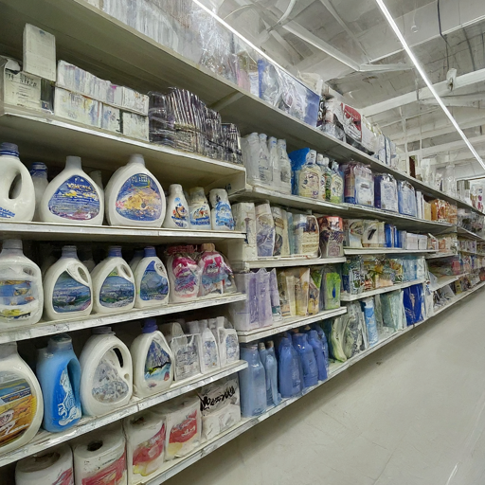
Automating Inventory Management: Product Detection and Counting with YOLOv8
we'll explore how computer vision can automate inventory management tasks, specifically focusing on product detection and counting using the YOLOv8 deep learning model.
Notes:
In today's presentation, we'll explore how computer vision can automate inventory management tasks, specifically focusing on product detection and counting using the YOLOv8 deep learning model. We'll delve into the challenges of manual inventory management, the benefits of automation, and the approach taken in this project to develop a YOLOv8-based solution.

Slide 3


The Challenge of Inventory Management
Manual counting is time-consuming and prone to errors.
Inaccurate inventory data leads to stockouts and lost sales.
Labor costs associated with manual counting can be significant.
Inaccurate inventory data can lead to stockouts, lost sales, and excess inventory holding costs. Additionally, manual counting requires significant labor resources, increasing operational expenses.
Notes:
Inventory management is a crucial aspect of retail operations. Traditionally, inventory is tracked through manual counting, which can be a tedious and error-prone process. Inaccurate inventory data can lead to stockouts, lost sales, and excess inventory holding costs. Additionally, manual counting requires significant labor resources, increasing operational expenses

Slide 4
Automating Inventory Management with Computer Vision
Computer vision offers a solution for automating inventory management.
Cameras can capture images of shelves and refrigerators.
Deep learning models can analyze images to detect and count products.
Notes:
Computer vision technology offers a promising solution for automating inventory management tasks. Cameras can be strategically placed on shelves and refrigerators to capture images of the products. Deep learning models, trained on large datasets of labeled images, can then analyze these images to detect and count the products with high accuracy.

Slide 5
Project Approach
Dataset acquisition: We obtained a dataset of images containing various products on shelves/refrigerators. (Roboflow)
Data preprocessing: Images were resized, normalized, and potentially augmented to improve model performance.
Model training: A pre-trained YOLO v8 model was fine-tuned on the acquired dataset.
Evaluation: The model's performance was evaluated using metrics like precision, recall, and F1-score.
Notes:
The project involved several key steps. First, we acquired a dataset of images containing various products on shelves and refrigerators. Data preprocessing techniques like resizing, normalization, and potentially data augmentation were applied to prepare the images for model training. Next, a pre-trained YOLOv8 model was fine-tuned on our specific dataset to improve its ability to detect and count the products of interest. Finally, the model's performance was evaluated using standard metrics to assess its accuracy, precision, recall, and F1-score.

Slide 6
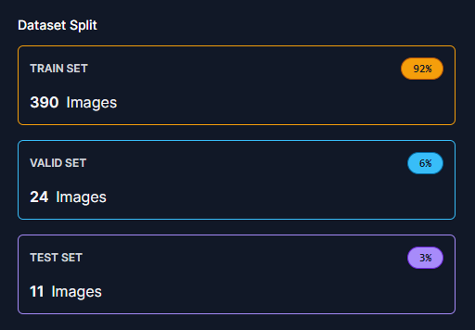
Data Sourcing and Preprocessing
title = { restpark67 Dataset },
type = { Open Source Dataset },
author = { bongwon park },
journal = { Roboflow Universe },
year = { 2023 }
The data is annotated and splited
restpark67 Dataset

Slide 7

Why YOLO v8 ?
YOLOv8 is a real-time object detection model.
It offers a good balance between accuracy and speed.
YOLOv8 is well-suited for resource-constrained environments.
Notes:
Among various object detection models, YOLOv8 stands out for its real-time processing capabilities. This is crucial for inventory management applications where fast results are essential. Additionally, YOLOv8 offers a good balance between accuracy in product detection and counting and the speed of processing images. This is particularly important for potentially resource-constrained environments like edge devices deployed in stores.

Slide 8
Model Training
We used some techniques that reduces time consumption and preparing model for transformation such as :
epochs=300
imgsz=640
batch=-1
cache=True
patience=50
profile=True
format='onnx'

Slide 9

Results

Slide 10
Results
Class Images Instances Box(P R mAP50 mAP50-95): 100% 1/1
all 24 275 0.905 0.821 0.875 0.586
empty 13 37 0.9 0.757 0.816 0.451
product 24 238 0.909 0.885 0.934 0.721
Speed: 0.2ms preprocess, 10.3ms inference, 0.0ms loss, 1.0ms postprocess per image

Slide 11
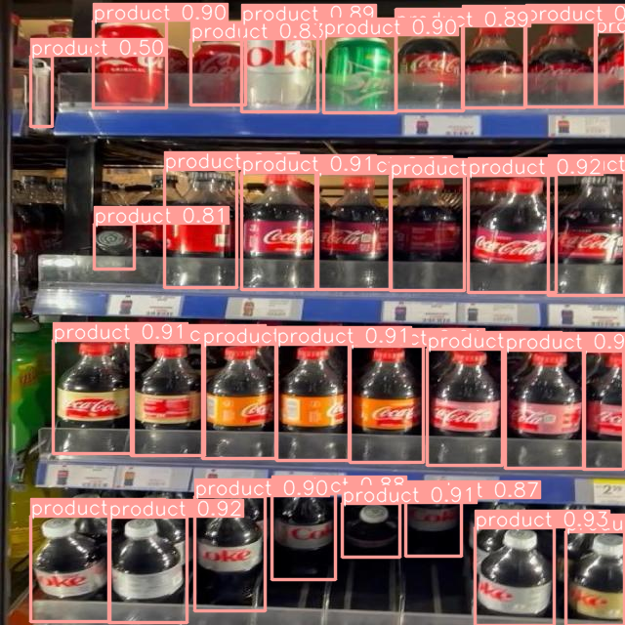
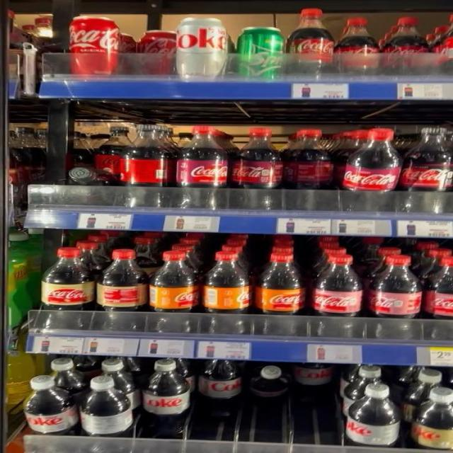
0: 640x640 32 products, 37.2ms
Speed: 2.1ms preprocess, 37.2ms inference, 2.0ms postprocess per image

Slide 12
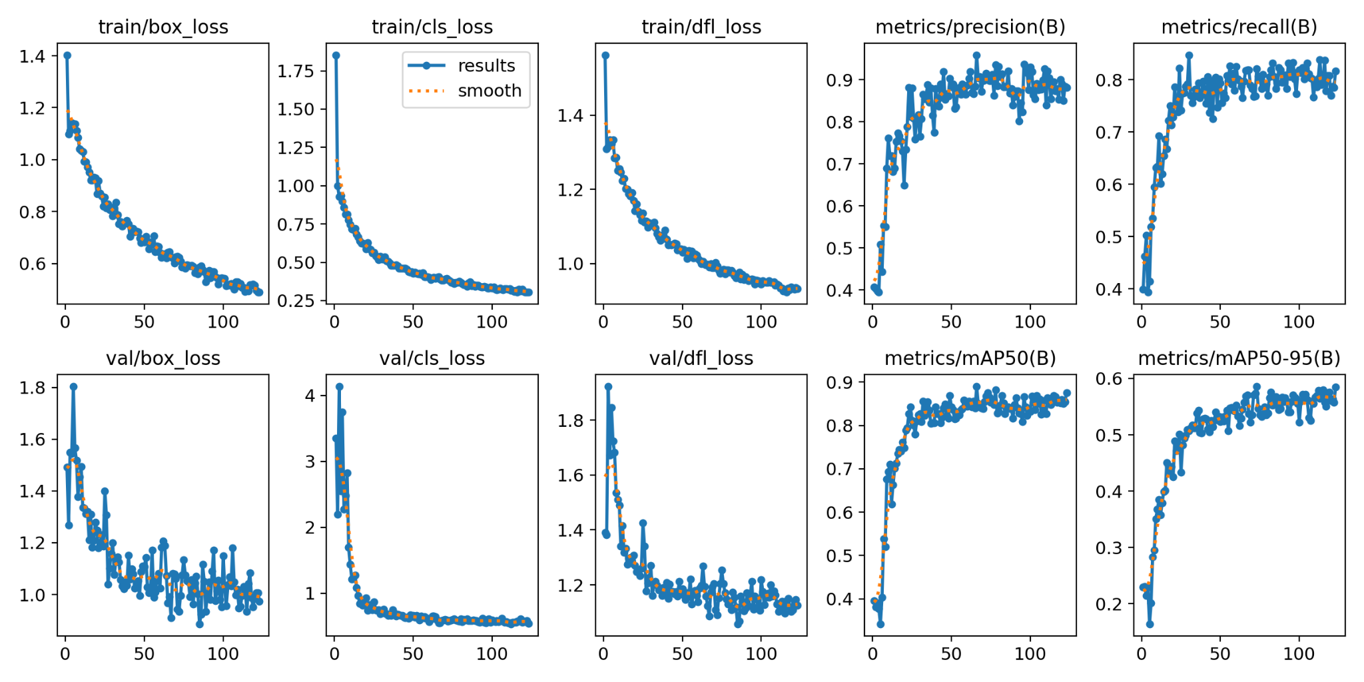

Slide 13
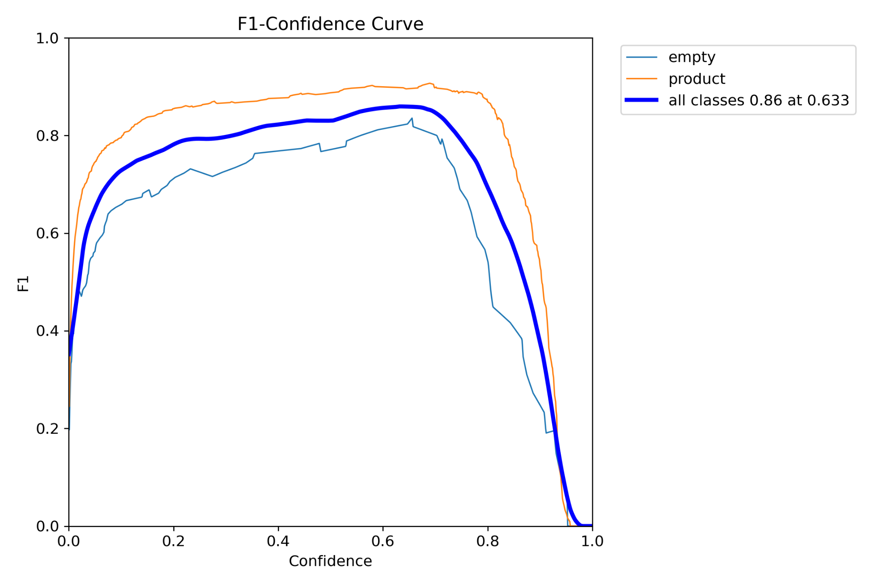
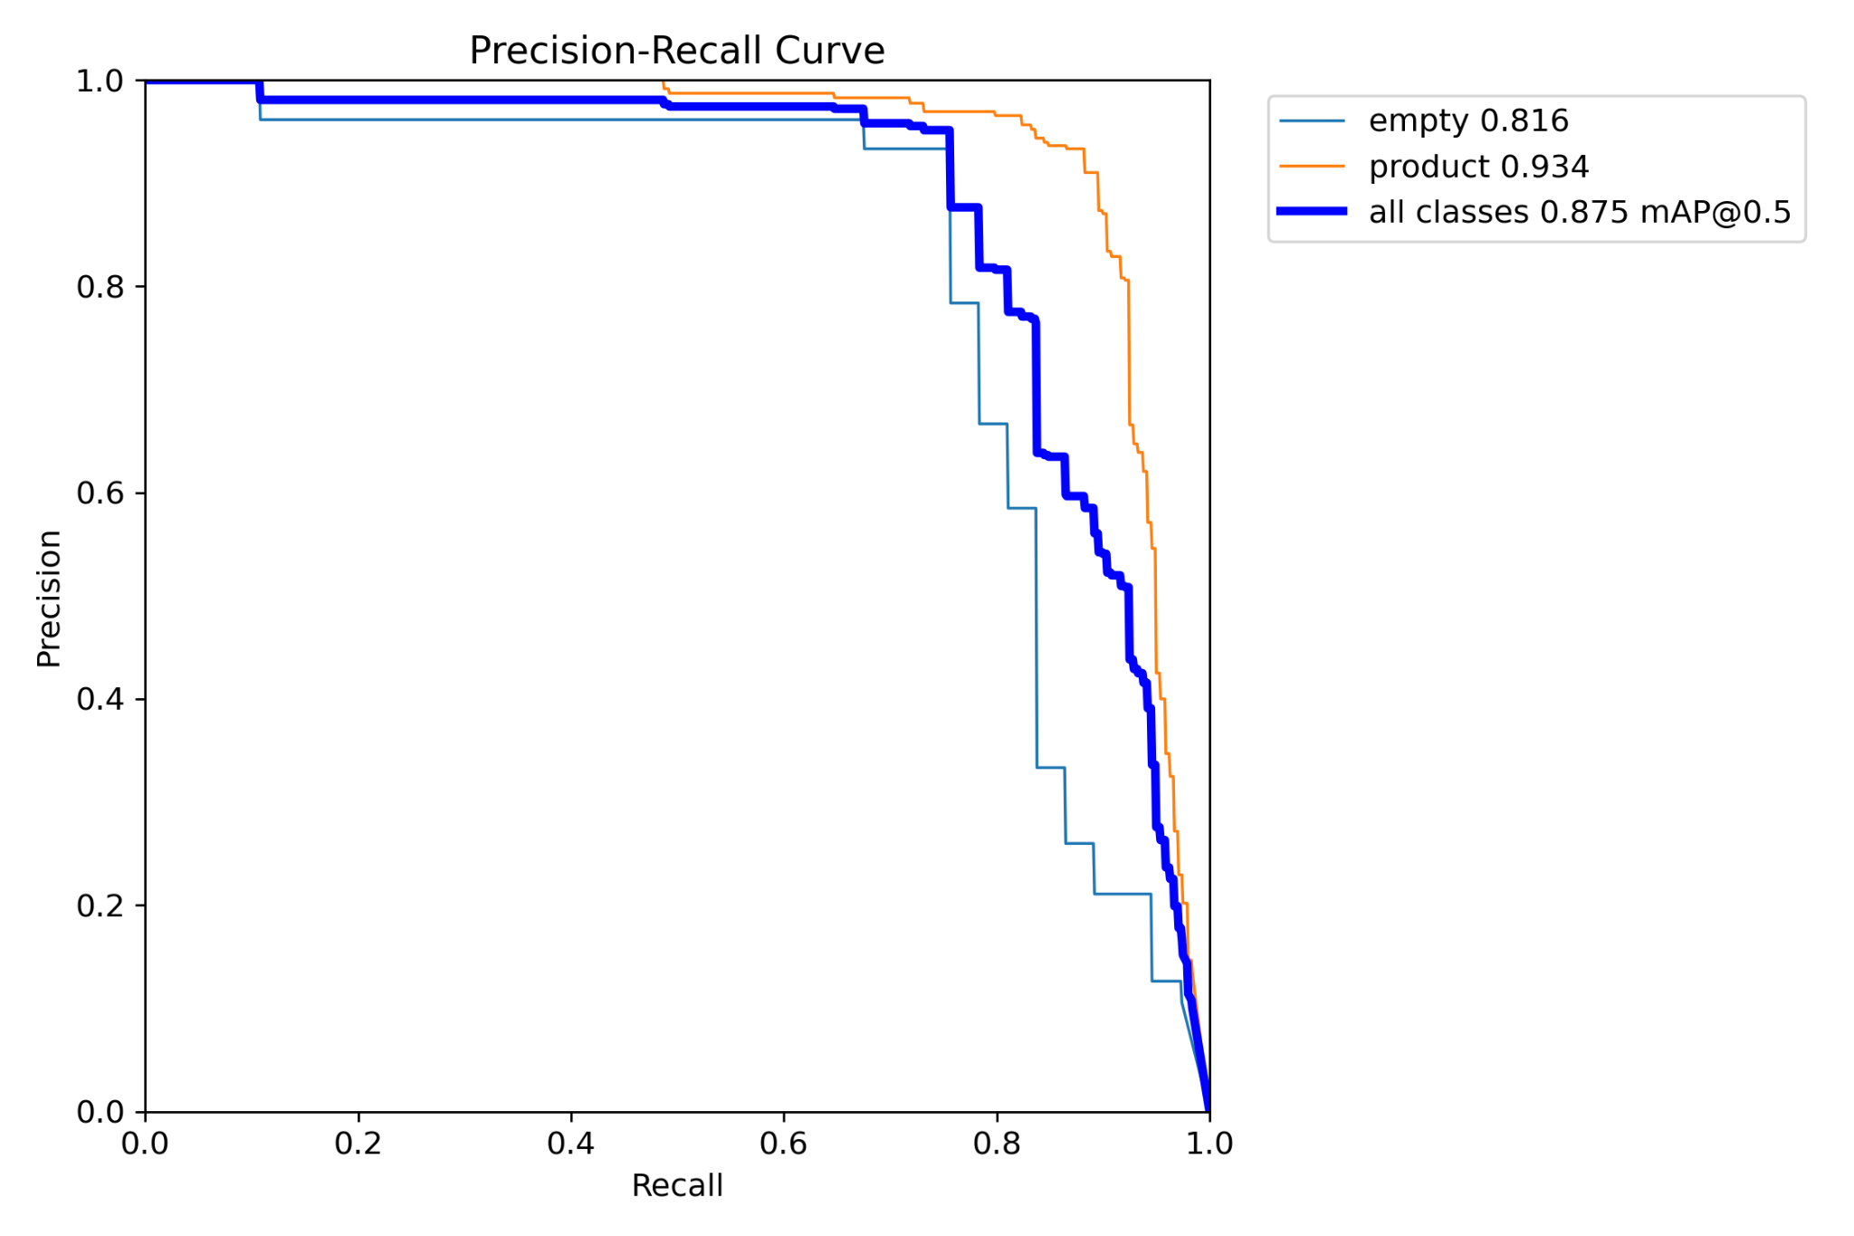

Slide 14
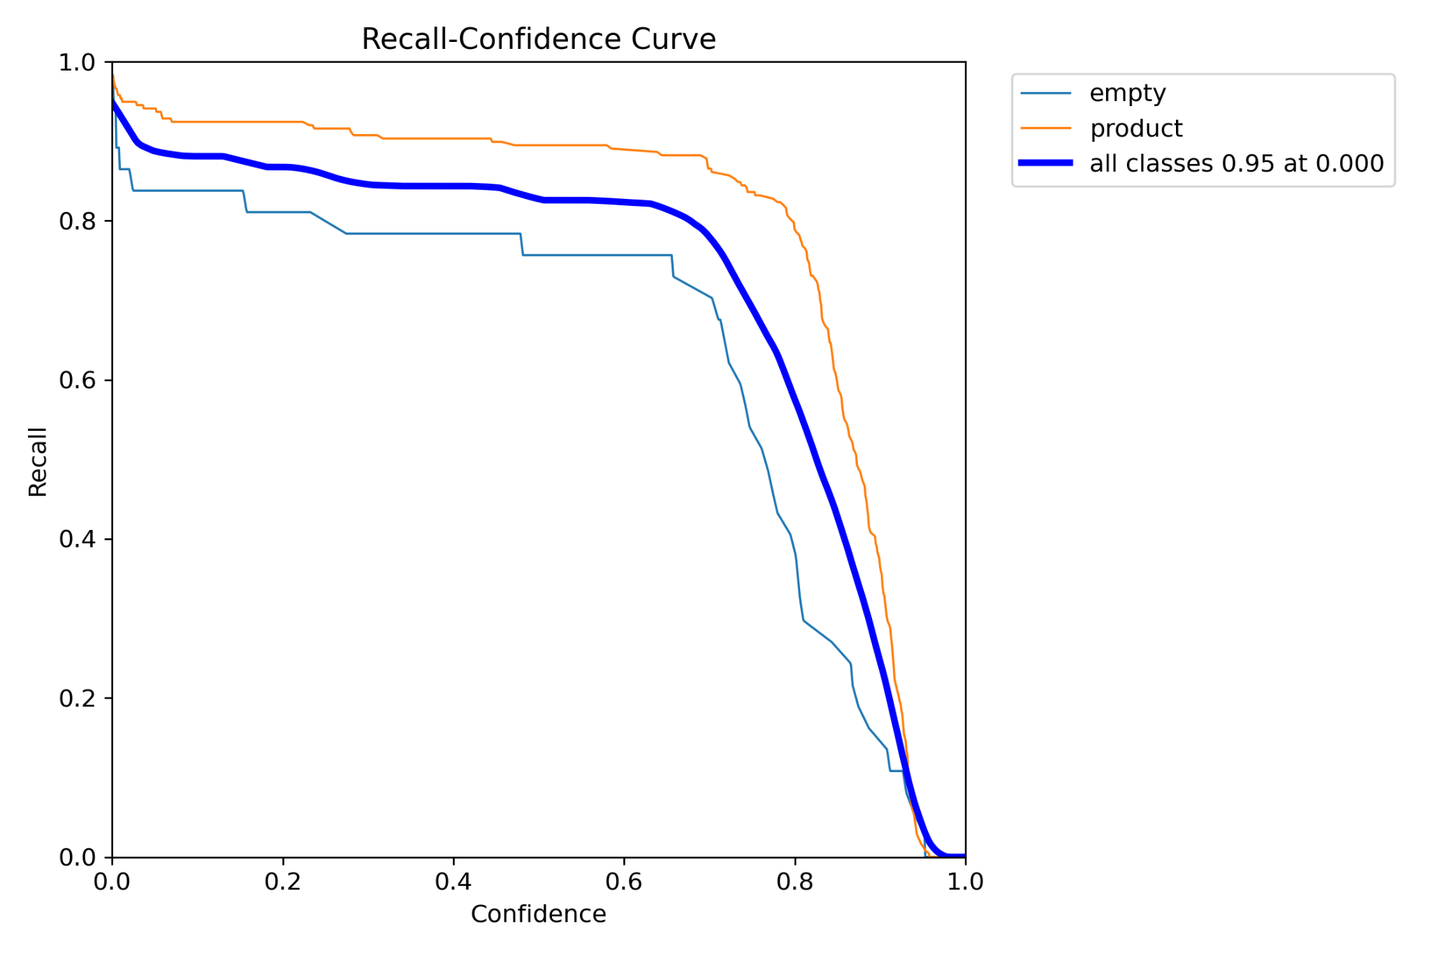
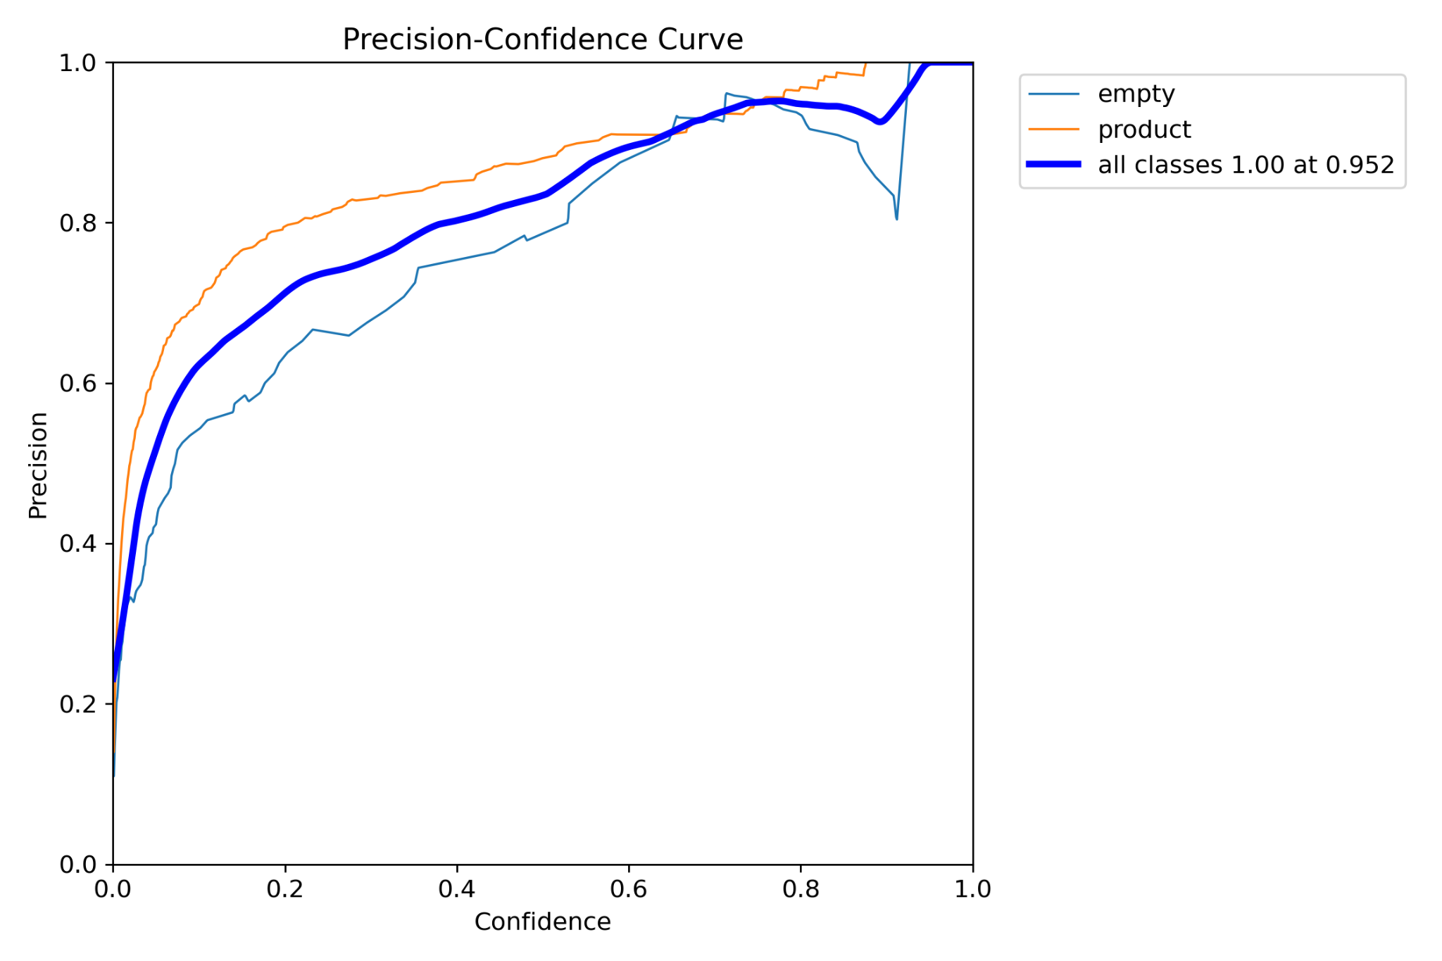

Slide 15
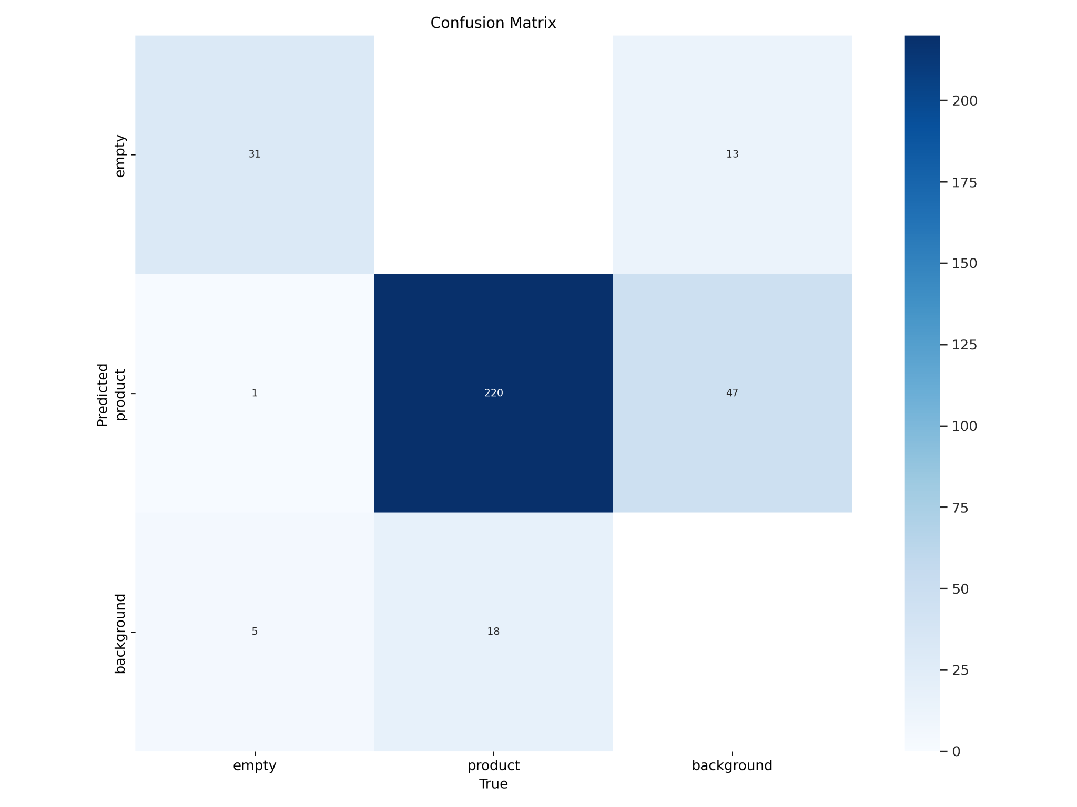
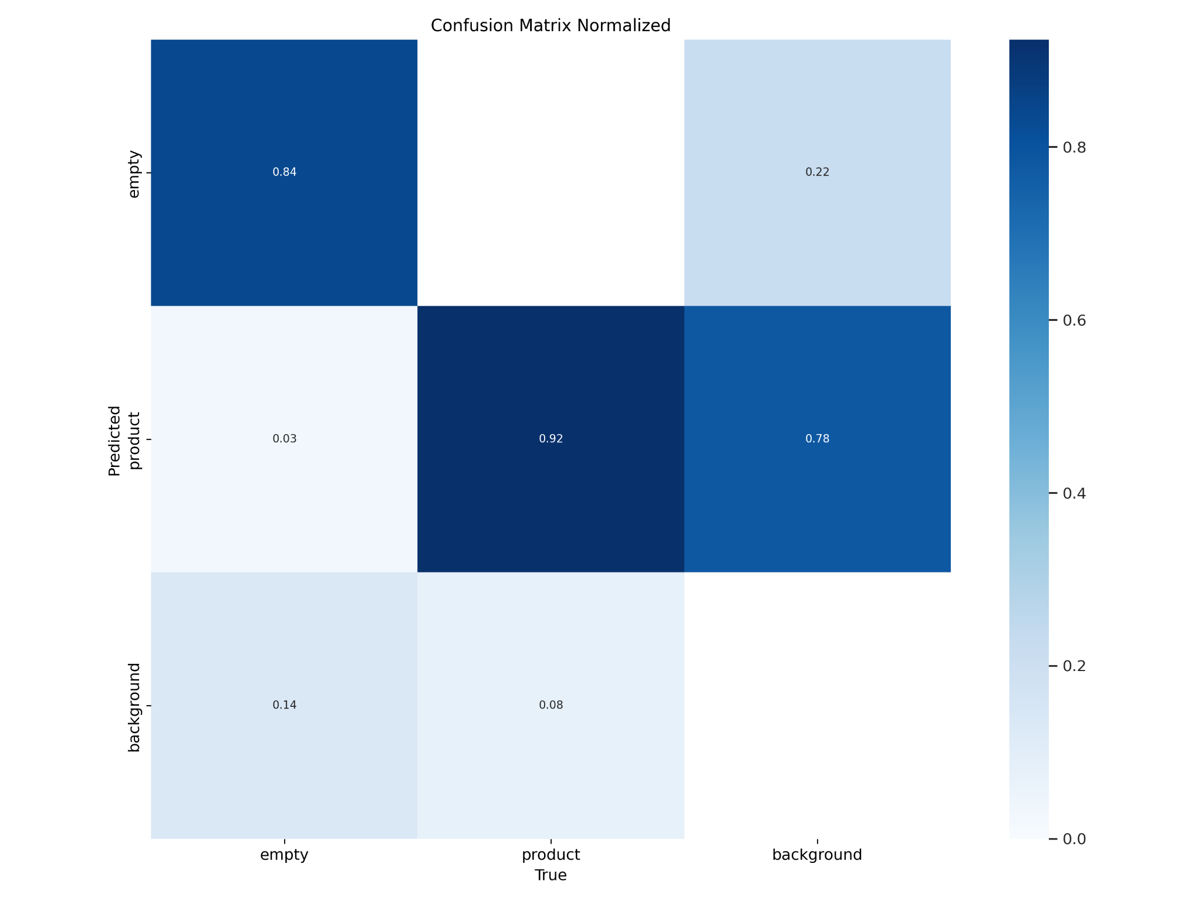

Slide 16
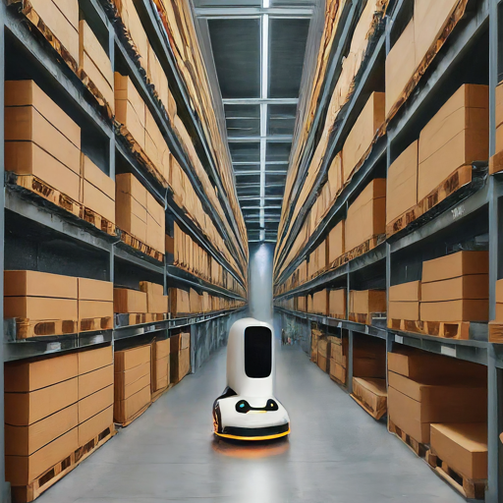
Conclusion
YOLOv8 is a powerful tool for automating product detection and counting in inventory management.
The model offers high accuracy and can be optimized for deployment on edge devices.
This technology has the potential to revolutionize inventory management processes, improving efficiency and reducing costs.

